Slide 1
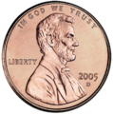






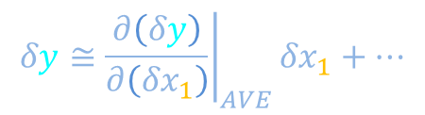
Prevalence of Gaussian distributions
Central limit theorem
Gaussians in physics
$$δy≅{\left.\frac{∂\left(δy\right)}{∂\left({δx}_{1}\right)}\right|}_{AVE}{δx}_{1}+⋯$$
Slightly-disguised Gaussians in biology
$$P\left(δx\right)$$
$$P\left(y_{ST}\right)$$
$$\frac{δx}{σ}$$
$$y_{ST}$$
-1
0
1
0

Slide 2

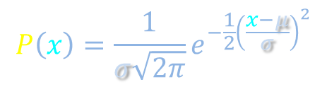

Central limit theorem
$$P\left(δx\right)$$
T
H
$$\frac{δx}{σ}$$
-3
-2
-1
0
1
2
3
$$P\left(x\right)=\frac{1}{σ\sqrt{2π}}e^{−\frac{1}{2}{\left(\frac{x−μ}{σ}\right)}^{2}}$$

Slide 3
Prevalence of Gaussian distributions
Central limit theorem
Gaussians in physics
$$δy≅{\left.\frac{∂\left(δy\right)}{∂\left({δx}_{1}\right)}\right|}_{AVE}{δx}_{1}+⋯$$
Slightly-disguised Gaussians in biology
$$P\left(δx\right)$$
$$P\left(y_{ST}\right)$$
$$\frac{δx}{σ}$$
$$y_{ST}$$
-1
0
1
0

Slide 4
Physics lab: Engineered for tightly-controlled noise

Slide 5
Physics lab: Engineered for tightly-controlled noise

Slide 6



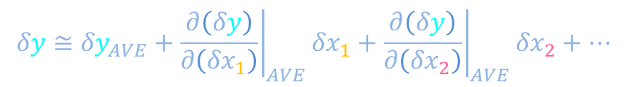

Physics lab: Engineered for tightly-controlled noise
Hook vibration
x₁
$$δy=δy\left({δx}_{1},δx_{2},{δx}_{3},⋯\right)$$
x₂
“Small” noise: Neglect quadratic terms in Taylor expansion
Uneven air flow
0
$$δy≅{δy}_{AVE}+{\left.\frac{∂\left(δy\right)}{∂\left({δx}_{1}\right)}\right|}_{AVE}{δx}_{1}+{\left.\frac{∂\left(δy\right)}{∂\left({δx}_{2}\right)}\right|}_{AVE}{δx}_{2}+⋯$$
$$Y$$
$$X_{1}$$
$$X_{2}$$
x₃
Thermal fluctuations
y
V
Twisting
x₄
t
x₅
Laser pointer vibration

Slide 7
Prevalence of Gaussian distributions
Central limit theorem
Gaussians in physics
$$δy≅{\left.\frac{∂\left(δy\right)}{∂\left({δx}_{1}\right)}\right|}_{AVE}{δx}_{1}+⋯$$
Slightly-disguised Gaussians in biology
$$P\left(δx\right)$$
$$P\left(y_{ST}\right)$$
$$\frac{δx}{σ}$$
$$y_{ST}$$
-1
0
1
0

Slide 8
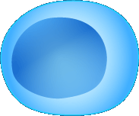

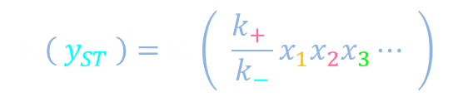

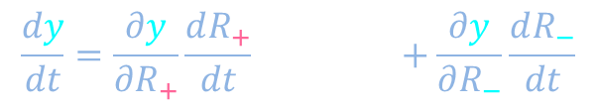







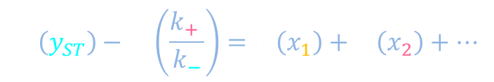



Biology: Law of mass action and logarithms
y
+1
-1
$$\frac{dy}{dt}=\frac{∂y}{∂R_{+}}\frac{dR_{+}}{dt} +\frac{∂y}{∂R_{−}}\frac{dR_{−}}{dt}$$
$$k_{+} x_{1}x_{2}x_{3}⋯$$
$$k_{−}y$$
x₂
$$0=k_{+} x_{1}x_{2}x_{3}⋯−k_{−}y_{ST}$$
$$k_{+}$$
$$k_{−}$$
y
x₁
x₃
$$k_{−}y_{ST}=k_{+} x_{1}x_{2}x_{3}⋯$$
$$R_{+}$$
$$R_{−}$$
$$\ln\left( y_{ST} \right)=\ln\left( \frac{k_{+} }{k_{−}}x_{1}x_{2}x_{3}⋯ \right)$$
Fluctuations in x₁, x₂, x₃, etc. are not necessarily engineered to be small. First-order Taylor-expansion might be inaccurate.
y
y
y
$$\ln\left(y_{ST}\right)=\ln\left(\frac{k_{+} }{k_{−}}\right)+\ln\left(x_{1}\right)+\ln\left(x_{2}\right)+⋯$$
$$\ln\left(y_{ST}\right)−\ln\left(\frac{k_{+} }{k_{−}}\right)=\ln\left(x_{1}\right)+\ln\left(x_{2}\right)+⋯$$
y
y
y
y
$$X_{1}$$
$$X_{2}$$
y
$$Y$$

Slide 9




Biology: Law of mass action and logarithms
A histogram of the logarithm of the number of copies of y displays a normal distribution
$$\ln\left(y_{ST}\right)−\ln\left(\frac{k_{+} }{k_{−}}\right)=\ln\left(x_{1}\right)+\ln\left(x_{2}\right)+⋯$$
$$X_{1}$$
$$X_{2}$$
$$Y$$
$$P\left[\ln\left(y_{ST}\right)\right]$$
$$P\left(y_{ST}\right)$$
e⁵ = 150
y_{ST} = e⁴ = 55
e⁶ = 400
$$\ln\left(y_{ST}\right)$$
0
$$y_{ST}$$
2
3
4
5
6
7
8
100
200
300
7
150
3000
0
150
300

